Slide 1
DATA MANIPULATION WITH PANDAS
DATACAMP
Kolawole David

Slide 2
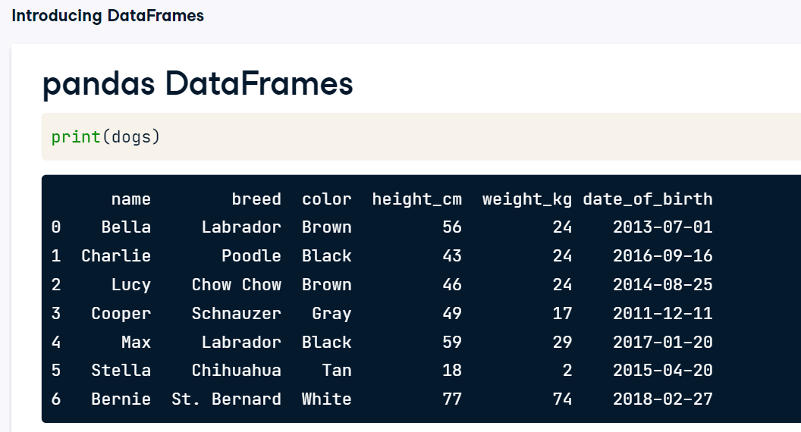

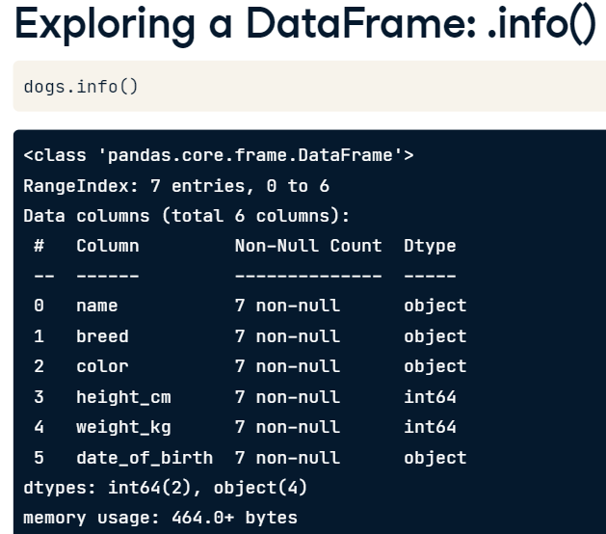
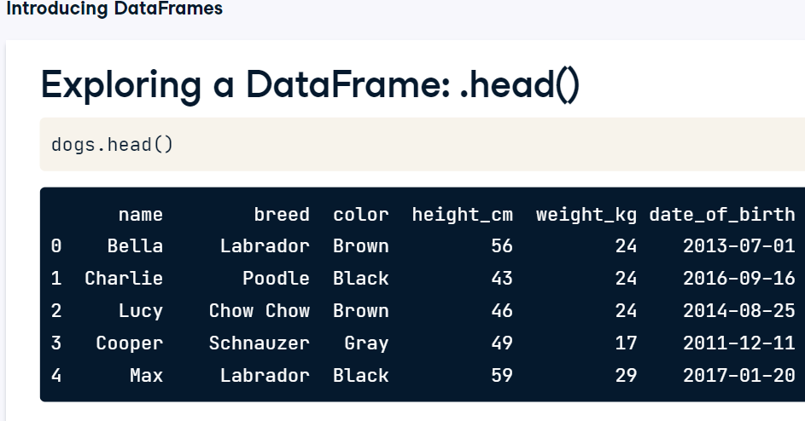
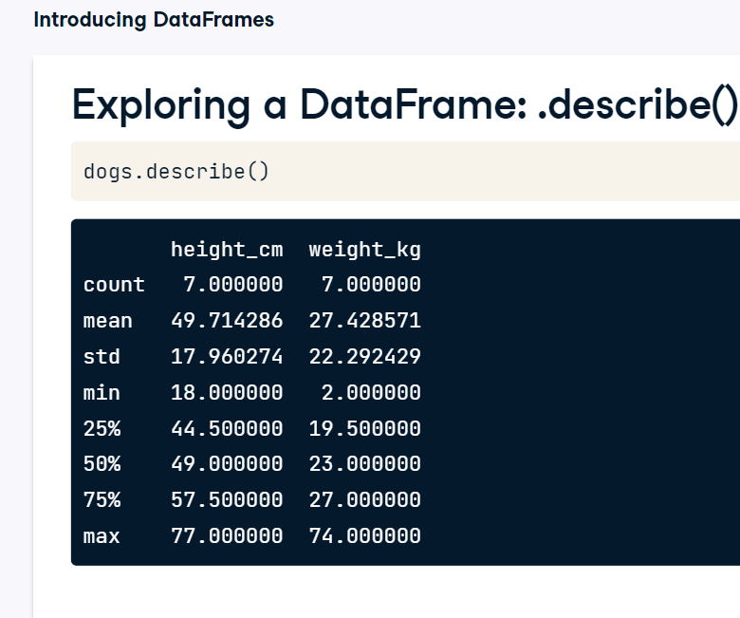
PANDAS

Slide 3
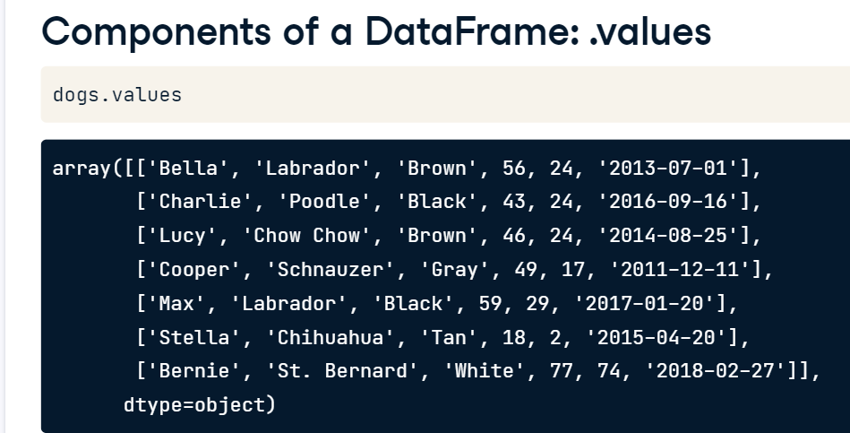
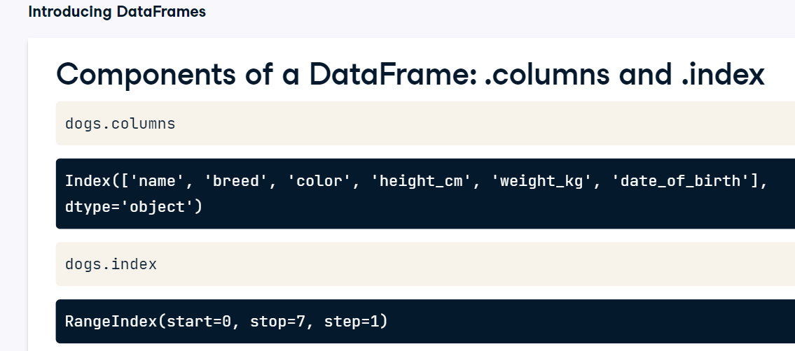

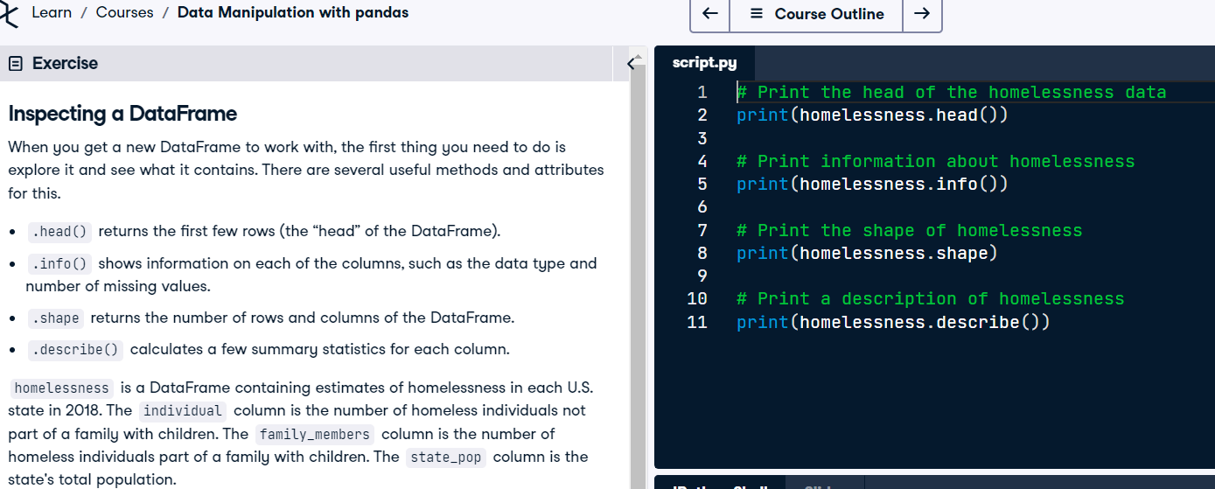
PANDAS

Slide 4
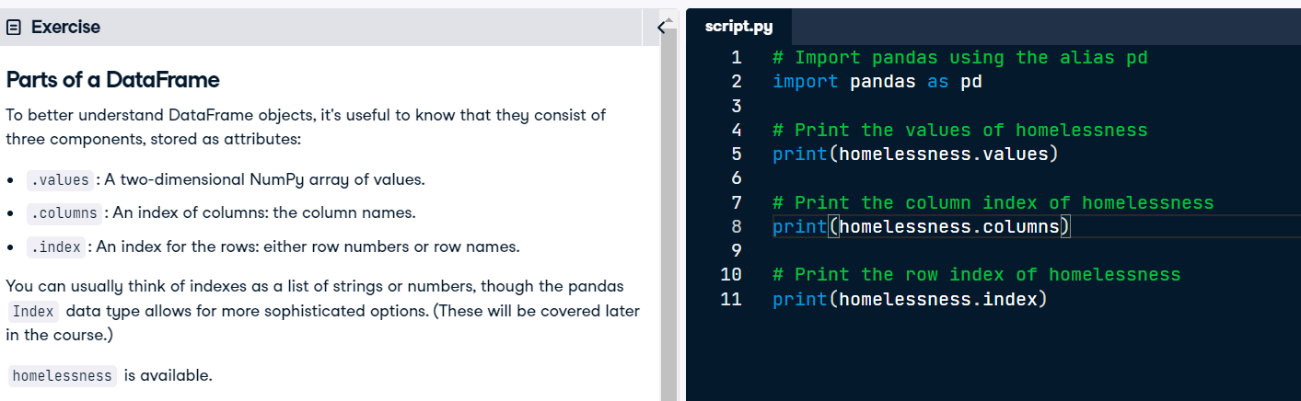
PANDAS

Slide 5
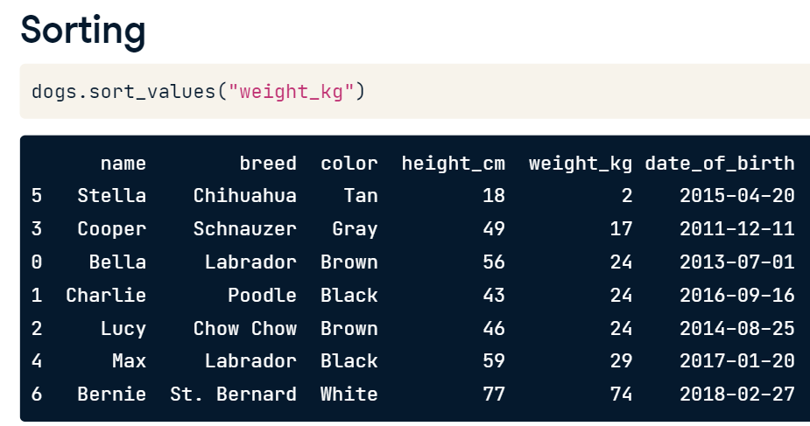
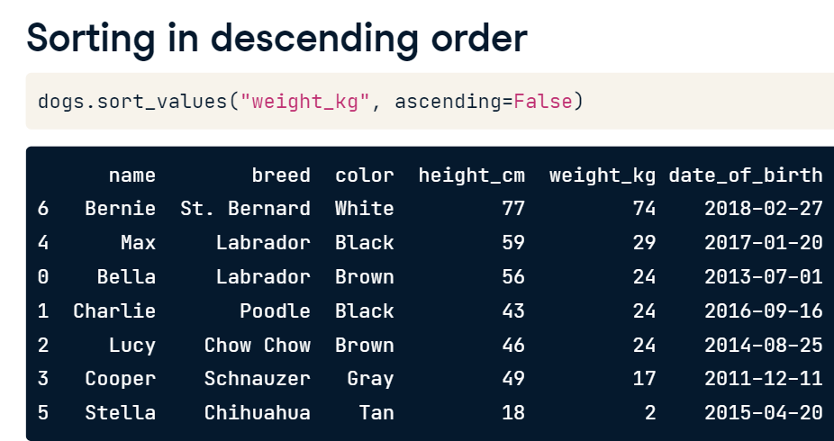
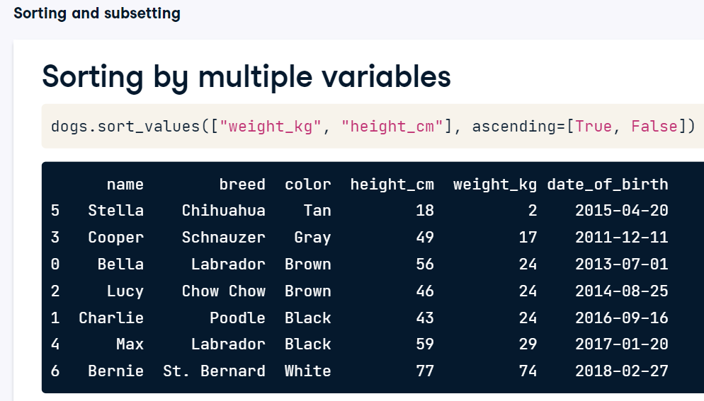
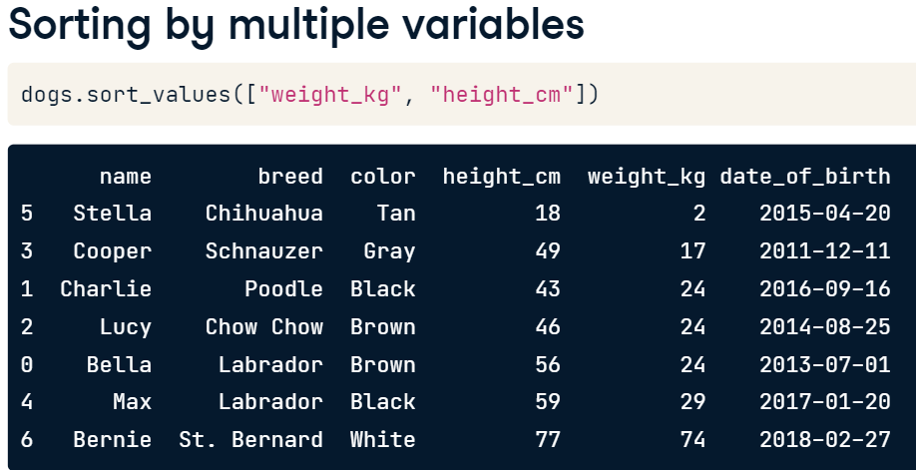
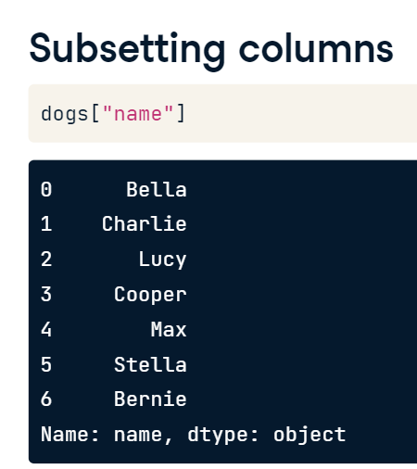
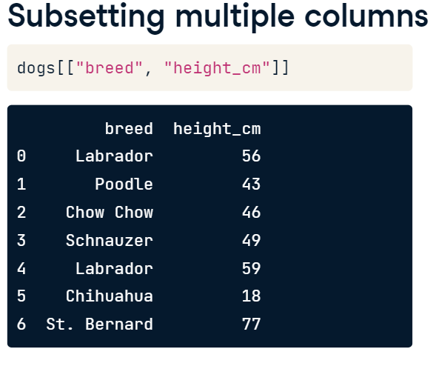
PANDAS : SORTING

Slide 6
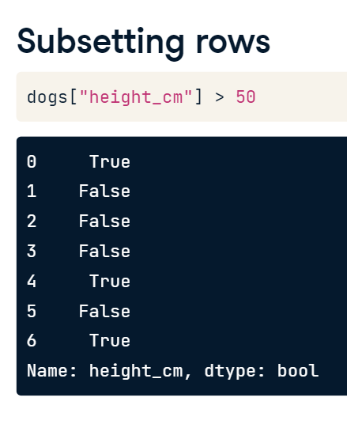
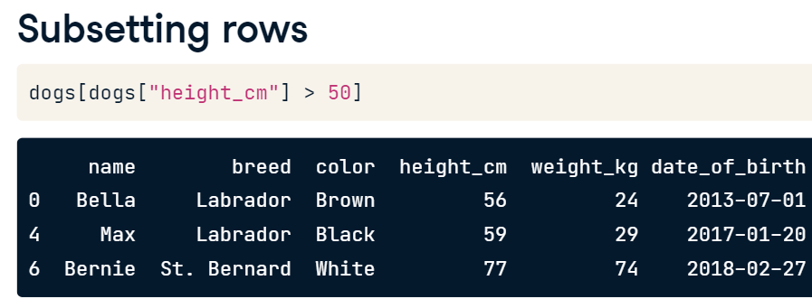
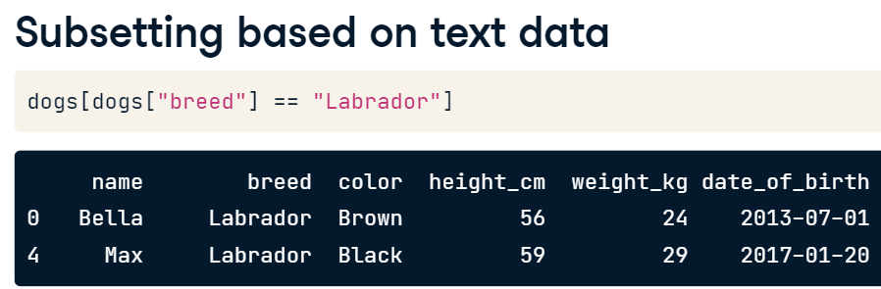
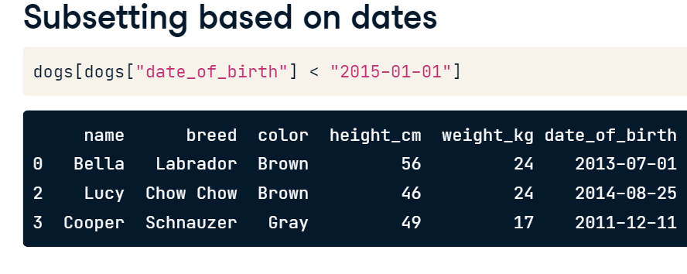
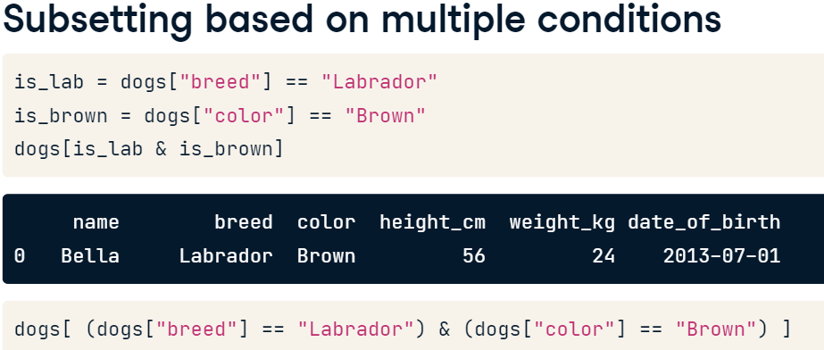
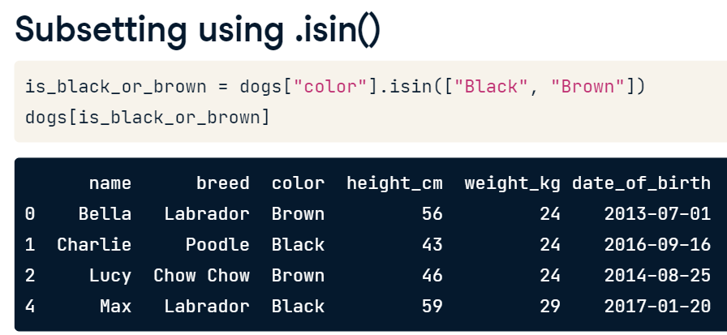
PANDAS: SUBSETTING

Slide 7
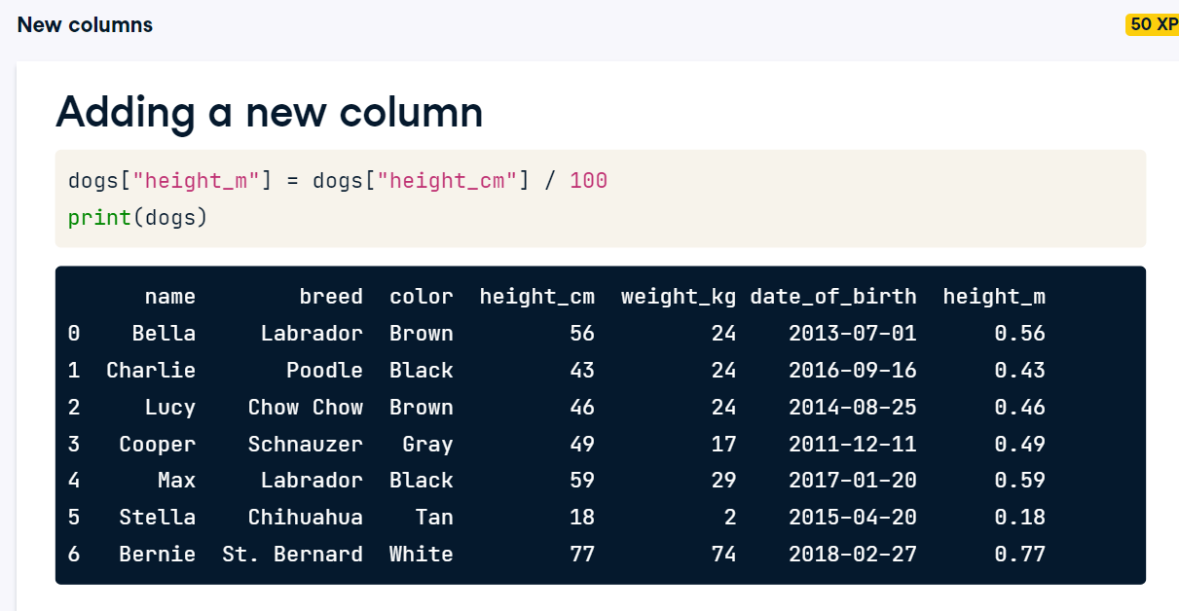
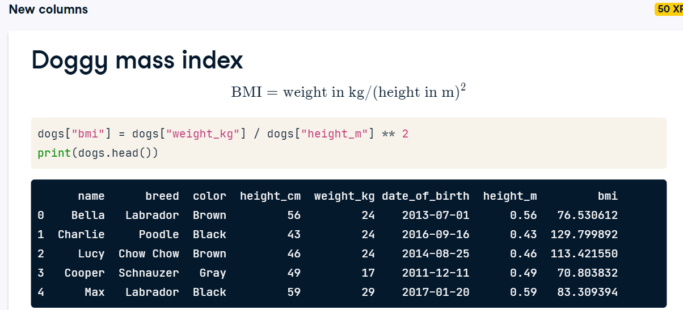
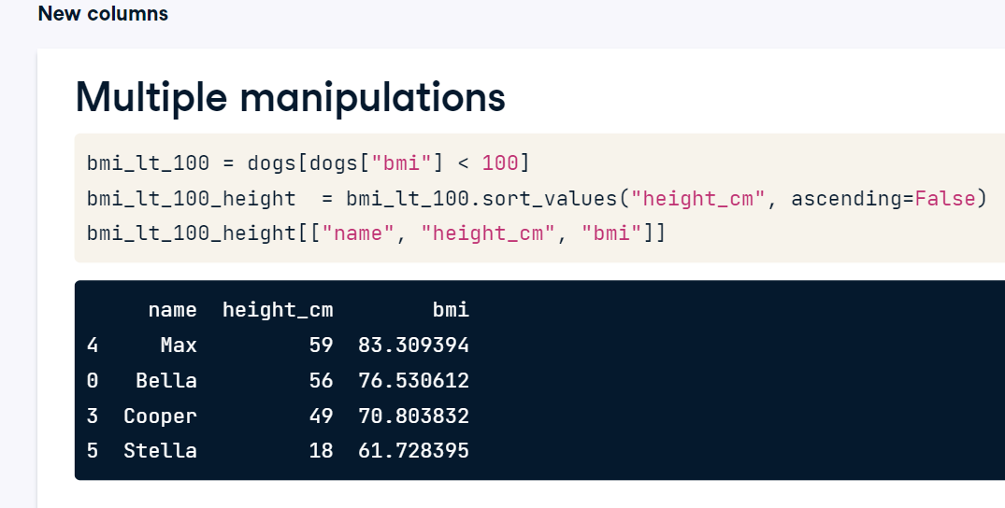
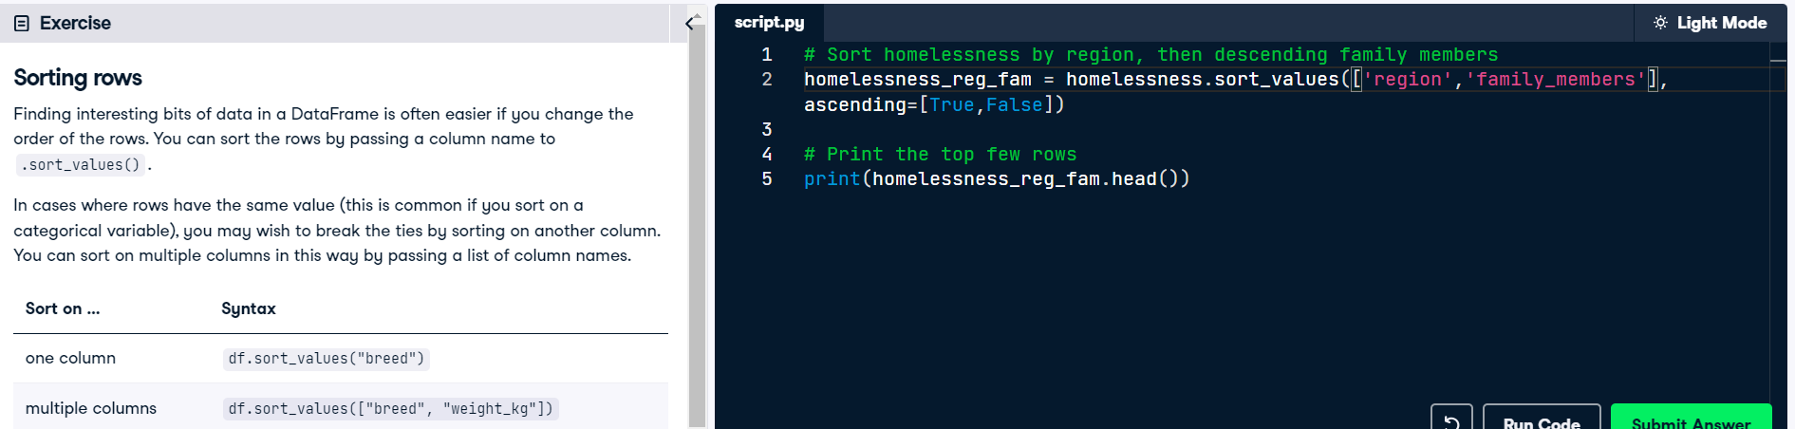
PANDAS

Slide 8
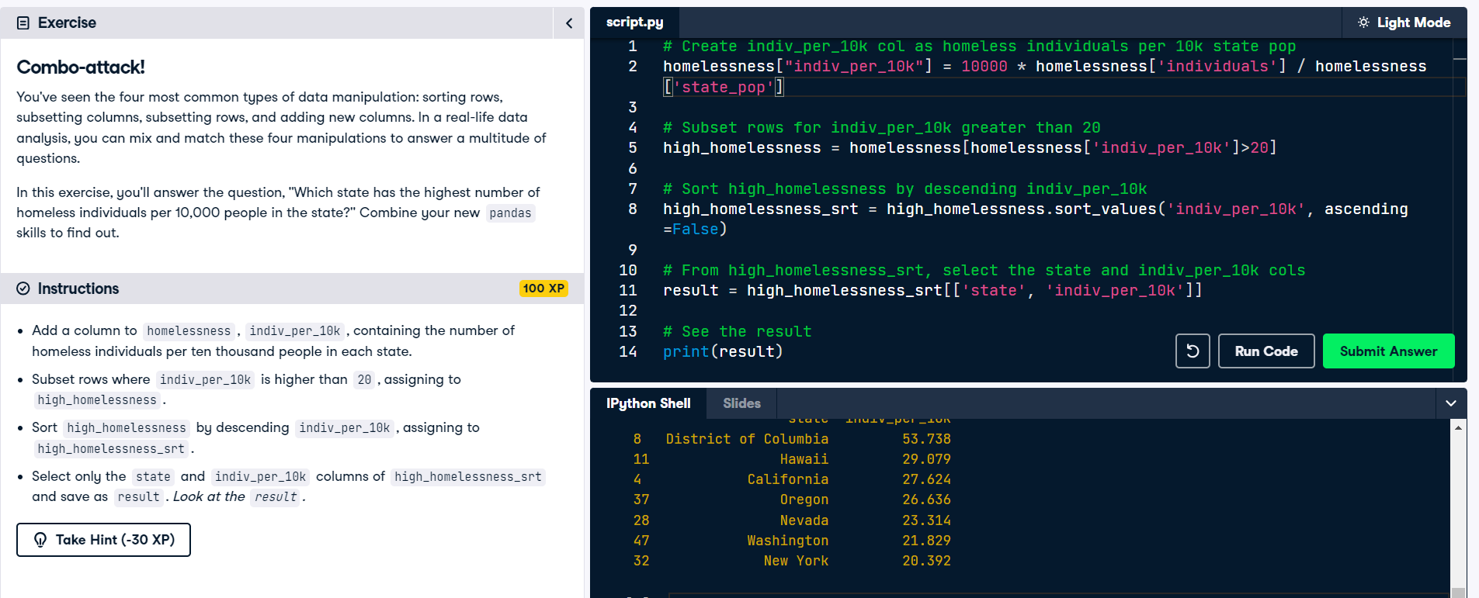
PANDAS

Slide 9
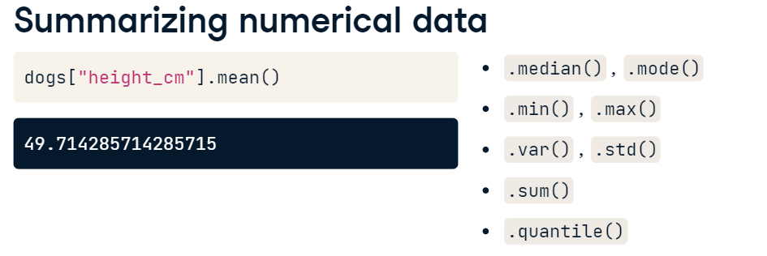
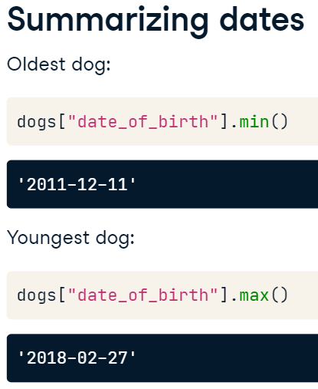
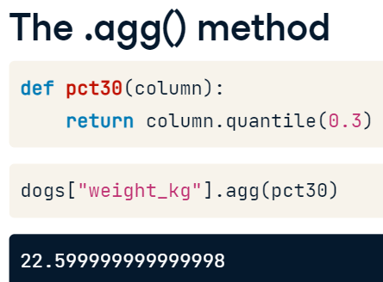
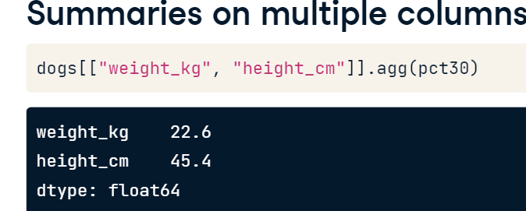
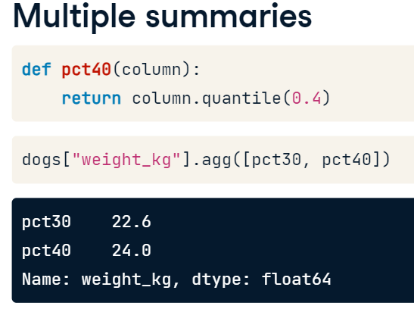
PANDAS

Slide 10
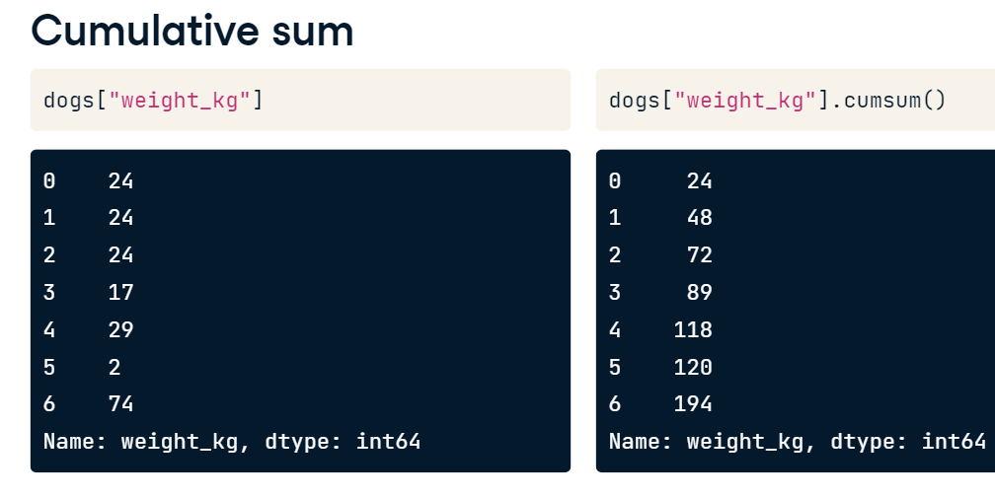
PANDAS

Slide 11
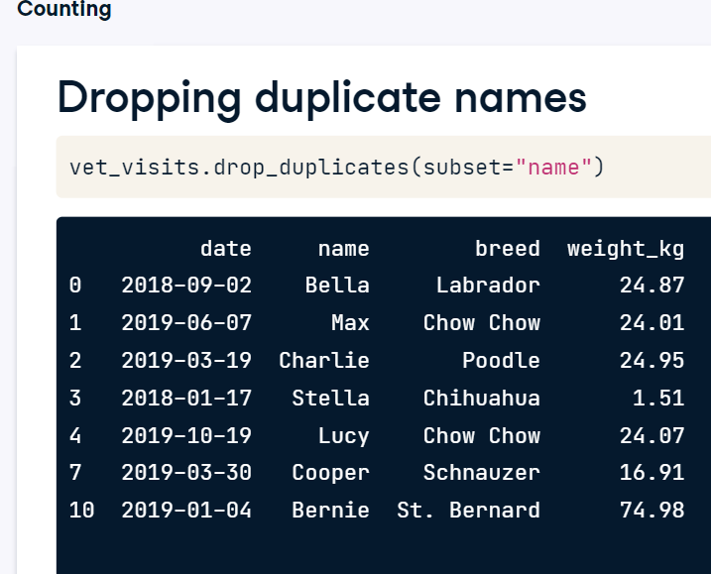
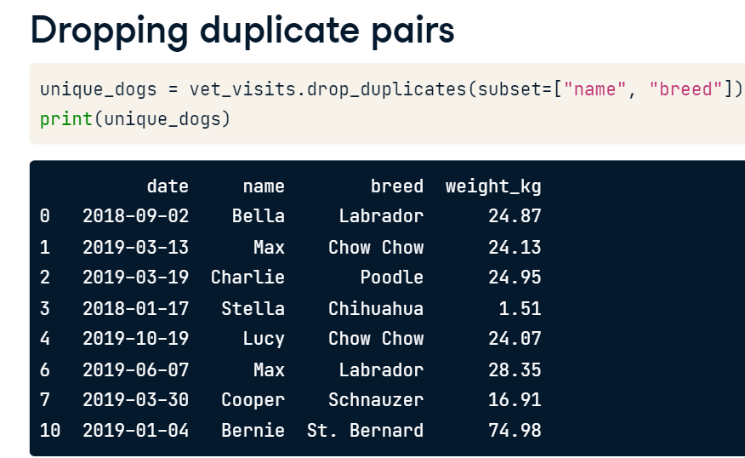
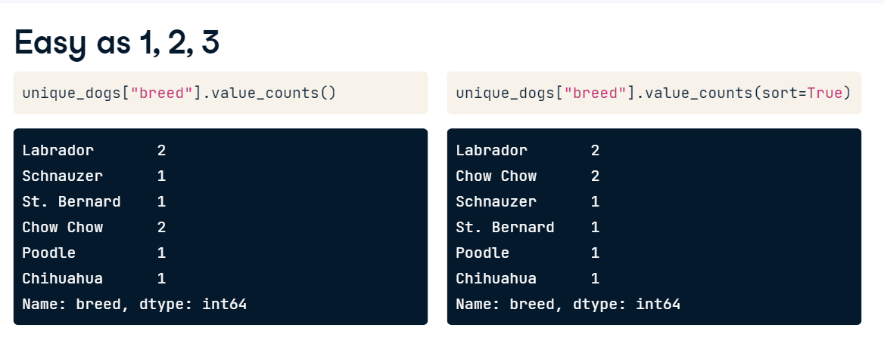
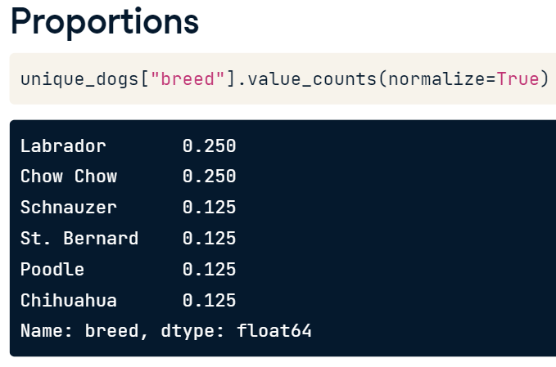
PANDAS : COUNTING & SUBSETTING FOR CATEGORICAL VARIABLES

Slide 12
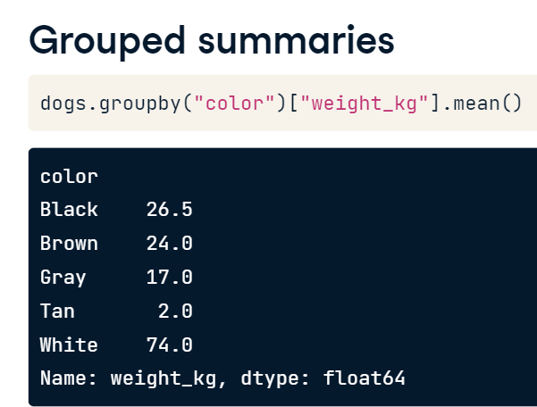
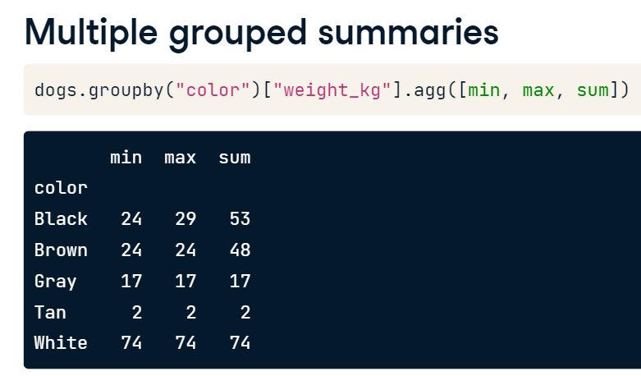
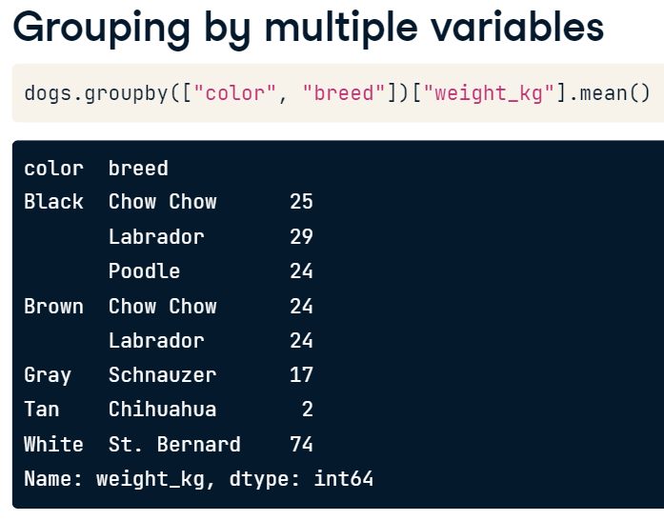
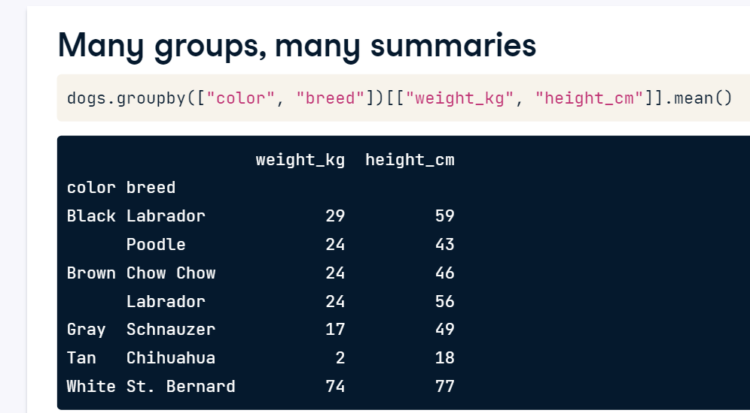
PANDAS

Slide 13
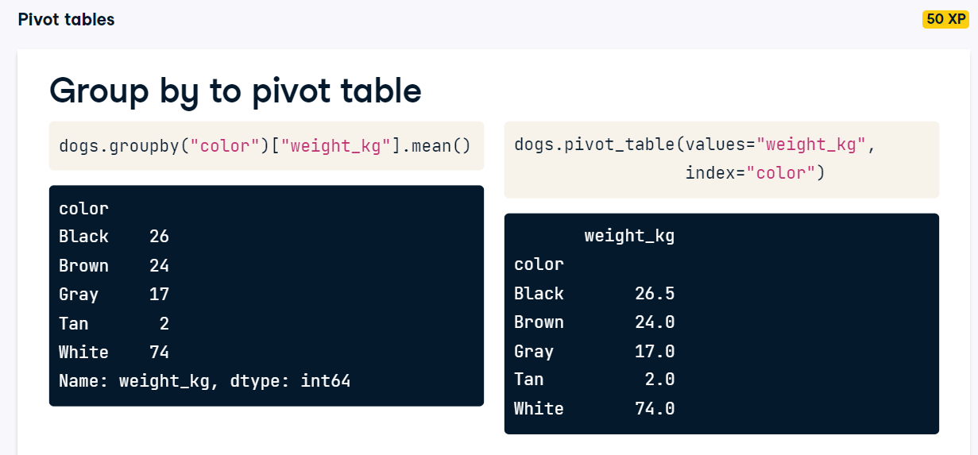
PANDAS

Slide 14
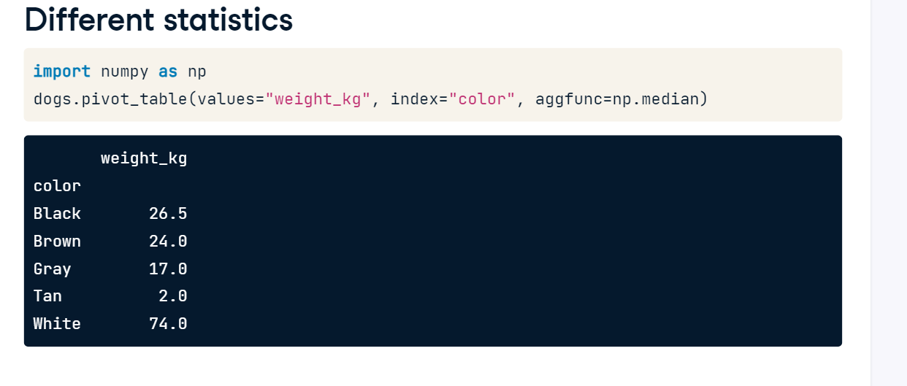
PANDAS

Slide 15
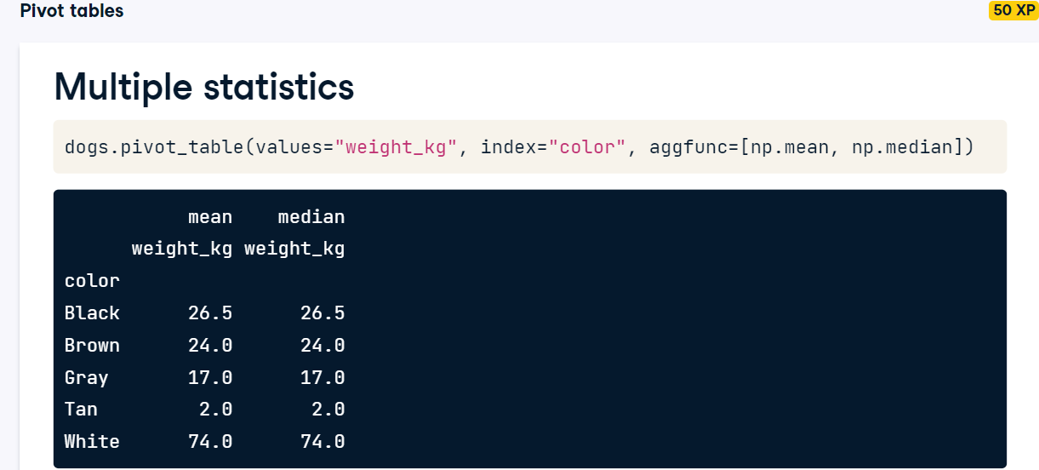
PANDAS

Slide 16
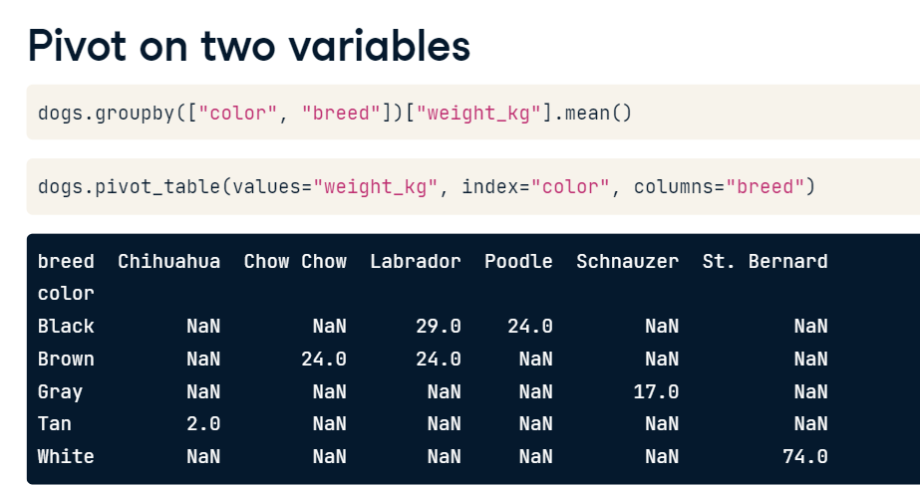
PANDAS

Slide 17
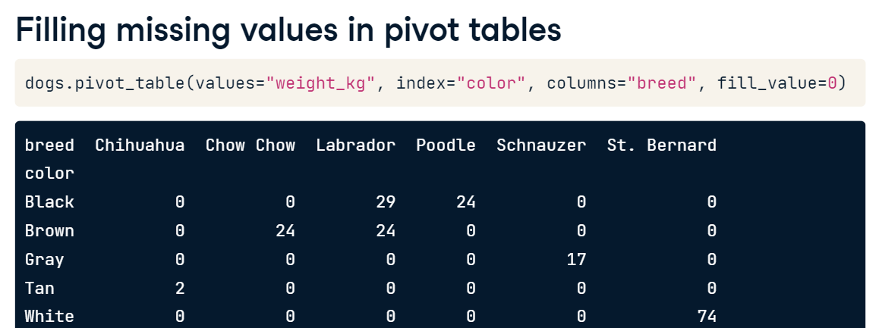
PANDAS
The mean is calculated by default

Slide 18
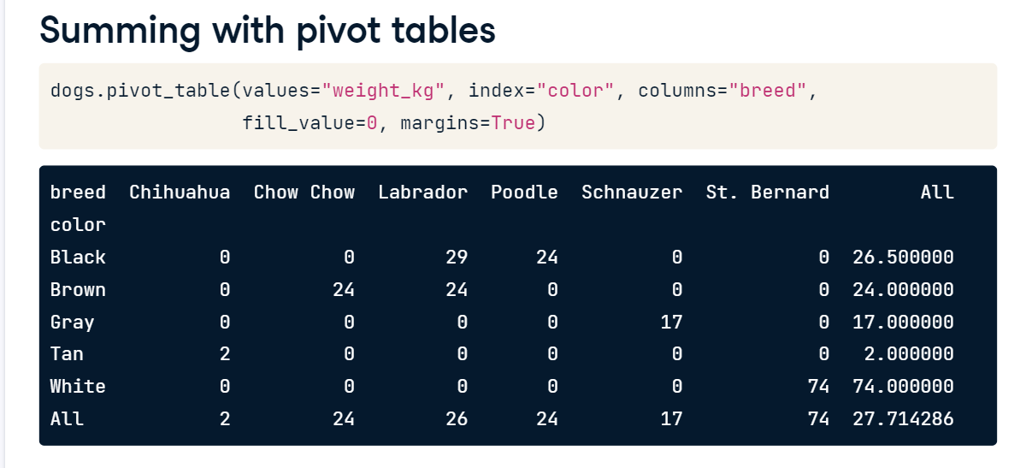
PANDAS
The all column represent mean of the records for each row and column

Slide 19
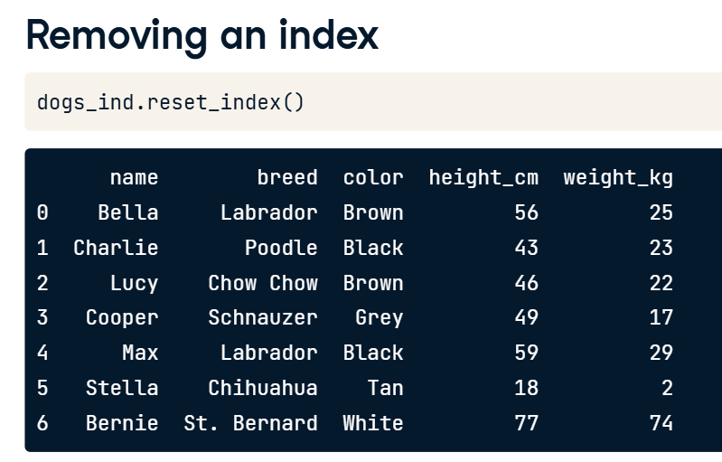
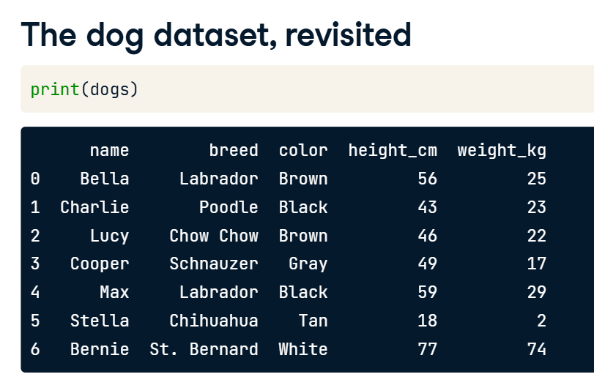
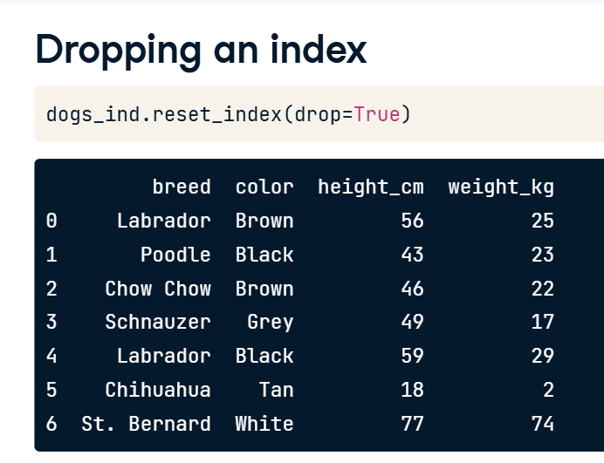
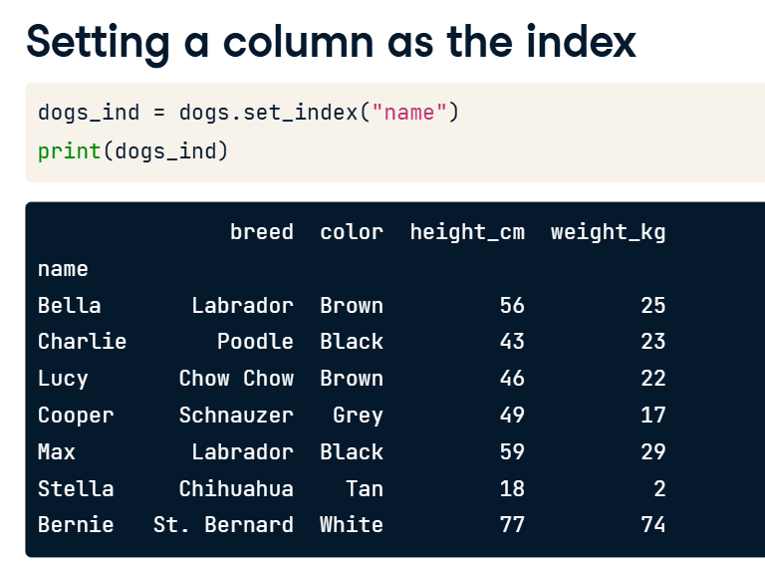
PANDAS

Slide 20
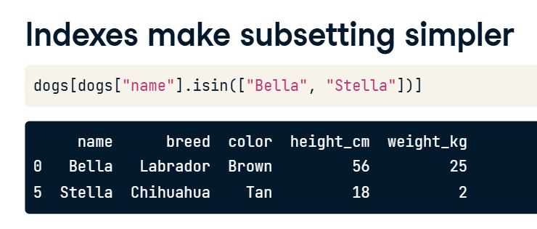

PANDAS :after converting names to index the 2nd snapshot appears easier

Slide 21


PANDAS

Slide 22



PANDAS

Slide 23


PANDAS

Slide 24

PANDAS

Slide 25

PANDAS
# Look at temperatures
print(temperatures)
# Set the index of temperatures to city
temperatures_ind = temperatures.set_index("city")
# Look at temperatures_ind
print(temperatures_ind)
# Reset the temperatures_ind index, keeping its contents
print(temperatures_ind.reset_index())
# Reset the temperatures_ind index, dropping its contents
print(temperatures_ind.reset_index(drop=True)

Slide 26

PANDAS
# Make a list of cities to subset on
cities = ["Moscow","Saint Petersburg"]
# Subset temperatures using square brackets
print(temperatures[temperatures["city"].isin(cities)])
# Subset temperatures_ind using .loc[]
print(temperatures_ind.loc[["Moscow","Saint Petersburg"]])

Slide 27
PANDAS
# Make a list of cities to subset on
cities = ["Moscow","Saint Petersburg"]
# Subset temperatures using square brackets
print(temperatures[temperatures["city"].isin(cities)])
# Subset temperatures_ind using .loc[]
print(temperatures_ind.loc[["Moscow","Saint Petersburg"]])

Slide 28

PANDAS
# Index temperatures by country & city
temperatures_ind = temperatures.set_index(["country","city"])
# List of tuples: Brazil, Rio De Janeiro & Pakistan, Lahore
rows_to_keep = [("Brazil","Rio De Janeiro"),("Pakistan","Lahore")]
# Subset for rows to keep
print(temperatures_ind.loc[rows_to_keep])

Slide 29

PANDAS
# Sort temperatures_ind by index values
print(temperatures_ind.sort_index())
# Sort temperatures_ind by index values at the city level
print(temperatures_ind.sort_index(level= ["city"]))
# Sort temperatures_ind by country then descending city
print(temperatures_ind.sort_index(level = ["country", "city"],ascending = [True,False]))

Slide 30

PANDAS

Slide 31

PANDAS

Slide 32

PANDAS

Slide 33

PANDAS
This approach is wrong : be careful

Slide 34

PANDAS

Slide 35

PANDAS

Slide 36

PANDAS

Slide 37

PANDAS

Slide 38

PANDAS

Slide 39

PANDAS

Slide 40

PANDAS

Slide 41

PANDAS
# Sort the index of temperatures_ind
temperatures_srt = temperatures_ind.sort_index()
# Subset rows from Pakistan to Russia
print(temperatures_srt.loc["Pakistan":"Russia"])
# Try to subset rows from Lahore to Moscow
print(temperatures_srt.loc["Lahore":"Moscow"])
# Subset rows from Pakistan, Lahore to Russia, Moscow
print(temperatures_srt.loc[("Pakistan", "Lahore"):("Russia", "Moscow")])

Slide 42

PANDAS
# Subset rows from India, Hyderabad to Iraq, Baghdad
print(temperatures_srt.loc[("India", "Hyderabad"):("Iraq", "Baghdad")])
# Subset columns from date to avg_temp_c
print(temperatures_srt.loc[:, "date" : "avg_temp_c"])
# Subset in both directions at once
print(temperatures_srt.loc[("India","Hyderabad"):("Iraq","Baghdad"),"date" : "avg_temp_c" ])

Slide 43

PANDAS

Slide 44
PANDAS
# Use Boolean conditions to subset temperatures for rows in 2010 and 2011
temperatures_bool = temperatures[(temperatures["date"] >= "2010-01-01") & (temperatures["date"] <= "2011-12-31")]
print(temperatures_bool)
# Set date as the index and sort the index
temperatures_ind = temperatures.set_index("date").sort_index()
# Use .loc[] to subset temperatures_ind for rows in 2010 and 2011
print(temperatures_ind.loc["2010":"2011"])
# Use .loc[] to subset temperatures_ind for rows from Aug 2010 to Feb 2011
print(temperatures_ind.loc["2010-08":"2011-02"])

Slide 45

PANDAS

Slide 46
PANDAS
# Get 23rd row, 2nd column (index 22, 1)
print(temperatures.iloc[22,1])
# Use slicing to get the first 5 rows
print(temperatures.iloc[0:5])
# Use slicing to get columns 3 to 4
print(temperatures.iloc[:,2:4])
# Use slicing in both directions at once
print(temperatures.iloc[0:5,2:4])

Slide 47

PANDAS

Slide 48


PANDAS
The sort_index learnt earlier can be used to perform similar pivot table actions

Slide 49

PANDAS
The sort_index learnt earlier can be used to perform similar pivot table actions

Slide 50


PANDAS
The sort_index learnt earlier can be used to perform similar pivot table actions

Slide 51
PANDAS
# Add a year column to temperatures
temperatures["year"] = temperatures["date"].dt.year
# Pivot avg_temp_c by country and city vs year
temp_by_country_city_vs_year = temperatures.pivot_table( "avg_temp_c" , index =["country","city"], columns = "year" )
# See the result
print(temp_by_country_city_vs_year)
The sort_index learnt earlier can be used to perform similar pivot table actions

Slide 52

PANDAS
# Subset for Egypt to India
temp_by_country_city_vs_year.loc["Egypt":"India"]
# Subset for Egypt, Cairo to India, Delhi
temp_by_country_city_vs_year.loc[("Egypt", "Cairo"):("India", "Delhi")]
# Subset for Egypt, Cairo to India, Delhi, and 2005 to 2010
temp_by_country_city_vs_year.loc[("Egypt", "Cairo"):("India", "Delhi"), "2005":"2010"]
The sort_index learnt earlier can be used to perform similar pivot table actions

Slide 53

PANDAS

Slide 54
PANDAS
# Get the worldwide mean temp by year
mean_temp_by_year = temp_by_country_city_vs_year.mean()
# Filter for the year that had the highest mean temp
print(mean_temp_by_year[mean_temp_by_year == mean_temp_by_year.max()])
# Get the mean temp by city
mean_temp_by_city = temp_by_country_city_vs_year.mean(axis ="columns")
# Filter for the city that had the lowest mean temp
print(mean_temp_by_city[mean_temp_by_city == mean_temp_by_city.min()])

Slide 55

PANDAS

Slide 56

PANDAS

Slide 57

PANDAS

Slide 58

PANDAS

Slide 59

PANDAS

Slide 60

PANDAS

Slide 61

PANDAS

Slide 62

PANDAS

Slide 63

PANDAS

Slide 64

PANDAS
# Import matplotlib.pyplot with alias plt
import matplotlib.pyplot as plt
# Look at the first few rows of data
print(avocados.head())
# Get the total number of avocados sold of each size
nb_sold_by_size = avocados.groupby("size")["nb_sold"].sum()
# Create a bar plot of the number of avocados sold by size
nb_sold_by_size.plot(kind ="bar")
# Show the plot
plt.show()

Slide 65

PANDAS
# Import matplotlib.pyplot with alias plt
import matplotlib.pyplot as plt
# Look at the first few rows of data
print(avocados.head())
# Get the total number of avocados sold of each size
nb_sold_by_size = avocados.groupby("size")["nb_sold"].sum()
# Create a bar plot of the number of avocados sold by size
nb_sold_by_size.plot(kind ="bar")
# Show the plot
plt.show()

Slide 66


PANDAS
# Import matplotlib.pyplot with alias plt
import matplotlib.pyplot as plt
# Get the total number of avocados sold on each date
nb_sold_by_date = avocados.groupby("date")["nb_sold"].sum()
# Create a line plot of the number of avocados sold by date
nb_sold_by_date.plot(kind="line")
# Show the plot
plt.show()

Slide 67


PANDAS
# Scatter plot of avg_price vs. nb_sold with title
avocados.plot(x ='nb_sold',y ='avg_price', kind = 'scatter', title ="Number of avocados sold vs. average price" )
# Show the plot
plt.show()

Slide 68


PANDAS
# Histogram of conventional avg_price
avocados[avocados["type"] == "conventional"]["avg_price"].hist()
# Histogram of organic avg_price
avocados[avocados["type"] == "organic"]["avg_price"].hist()
# Add a legend
plt.legend(["conventional", "organic"])
# Show the plot
plt.show()

Slide 69

PANDAS
# Modify histogram transparency to 0.5
avocados[avocados["type"] == "conventional"]["avg_price"].hist(alpha=0.5)
# Modify histogram transparency to 0.5
avocados[avocados["type"] == "organic"]["avg_price"].hist(alpha=0.5)
# Add a legend
plt.legend(["conventional", "organic"])
# Show the plot
plt.show()

Slide 70


PANDAS
# Modify bins to 20
avocados[avocados["type"] == "conventional"]["avg_price"].hist(alpha=0.5, bins=20)
# Modify bins to 20
avocados[avocados["type"] == "organic"]["avg_price"].hist(alpha=0.5, bins=20)
# Add a legend
plt.legend(["conventional", "organic"])
# Show the plot
plt.show()

Slide 71

PANDAS

Slide 72

PANDAS

Slide 73


PANDAS

Slide 74

PANDAS

Slide 75

PANDAS

Slide 76


PANDAS
# Import matplotlib.pyplot with alias plt
import matplotlib.pyplot as plt
# Check individual values for missing values
print(avocados_2016.isna())
# Check each column for missing values
print(avocados_2016.isna().any())
# Bar plot of missing values by variable
avocados_2016.isna().sum().plot(kind = "bar")
# Show plot
plt.show()

Slide 77

PANDAS
# Remove rows with missing values
avocados_complete = avocados_2016.dropna()
# Check if any columns contain missing values
print(avocados_complete.isna().any())

Slide 78


PANDAS
# List the columns with missing values
cols_with_missing = ["small_sold", "large_sold", "xl_sold"]
# Create histograms showing the distributions cols_with_missing
avocados_2016[cols_with_missing].hist()
# Show the plot
plt.show()

Slide 79


PANDAS
# From previous step
cols_with_missing = ["small_sold", "large_sold", "xl_sold"]
avocados_2016[cols_with_missing].hist()
plt.show()
# Fill in missing values with 0
avocados_filled = avocados_2016.fillna(0)
# Create histograms of the filled columns
avocados_filled[cols_with_missing].hist()
# Show the plot
plt.show()

Slide 80

PANDAS

Slide 81

PANDAS

Slide 82

PANDAS

Slide 83

PANDAS

Slide 84

PANDAS

Slide 85

PANDAS

Slide 86

PANDAS
# Create a list of dictionaries with new data
avocados_list = [
{"date": "2019-11-03", "small_sold": 10376832, "large_sold": 7835071},
{"date": "2019-11-10", "small_sold": 10717154, "large_sold": 8561348},
]
# Convert list into DataFrame
avocados_2019 = pd.DataFrame(avocados_list)
# Print the new DataFrame
print(avocados_2019)

Slide 87

PANDAS
# Create a dictionary of lists with new data
avocados_dict = {
"date": ["2019-11-17", "2019-12-01"],
"small_sold": [10859987, 9291631],
"large_sold": [7674135, 6238096]
}
# Convert dictionary into DataFrame
avocados_2019 = pd.DataFrame(avocados_dict)
# Print the new DataFrame
print(avocados_2019))

Slide 88

PANDAS

Slide 89

PANDAS

Slide 90

PANDAS

Slide 91

PANDAS

Slide 92

PANDAS
# Read CSV as DataFrame called airline_bumping
airline_bumping = pd.read_csv("airline_bumping.csv")
# Take a look at the DataFrame
print(airline_bumping.head())

Slide 93


PANDAS
# From previous step
airline_bumping = pd.read_csv("airline_bumping.csv")
print(airline_bumping.head())
# For each airline, select nb_bumped and total_passengers and sum
airline_totals = airline_bumping.groupby("airline")[["nb_bumped", "total_passengers"]].sum()
# From previous steps
airline_bumping = pd.read_csv("airline_bumping.csv")
print(airline_bumping.head())
airline_totals = airline_bumping.groupby("airline")[["nb_bumped", "total_passengers"]].sum()
# Create new col, bumps_per_10k: no. of bumps per 10k passengers for each airline
airline_totals["bumps_per_10k"] = airline_totals["nb_bumped"] / airline_totals["total_passengers"] * 10000

Slide 94

PANDAS
# From previous steps
airline_bumping = pd.read_csv("airline_bumping.csv")
print(airline_bumping.head())
airline_totals = airline_bumping.groupby("airline")[["nb_bumped", "total_passengers"]].sum()
airline_totals["bumps_per_10k"] = airline_totals["nb_bumped"] / airline_totals["total_passengers"] * 10000
# Print airline_totals
print(airline_totals)

Slide 95

PANDAS
# Create airline_totals_sorted
airline_totals_sorted = airline_totals.sort_values("bumps_per_10k", ascending=False)
# Print airline_totals_sorted
print(airline_totals_sorted)
# Save as airline_totals_sorted.csv
airline_totals_sorted.to_csv("airline_totals_sorted.csv")

Slide 96

PANDAS

